Slide 1

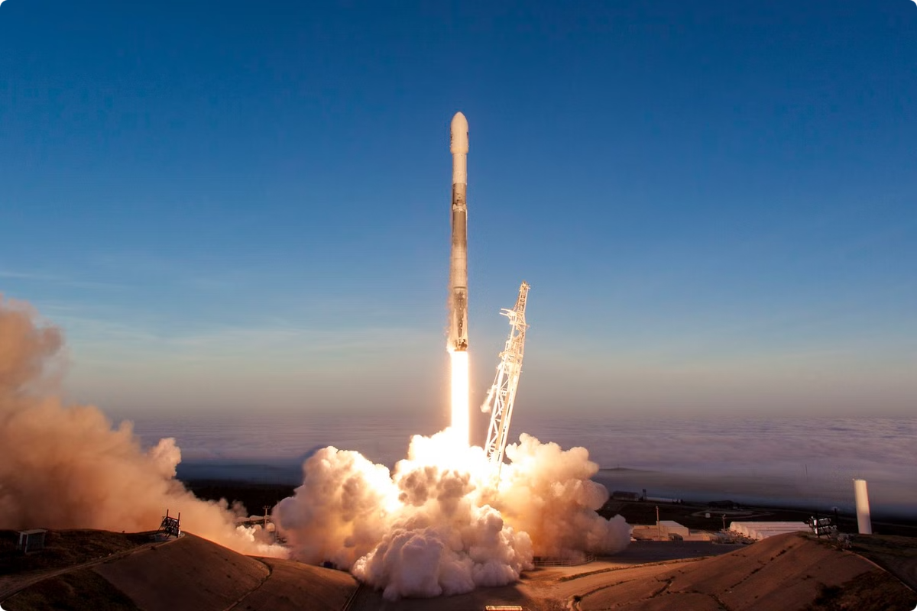
Data Mining SpaceX Launch Data
Predicting Launch Success, Optimizing Reusability, and Analyzing Cost Efficiency

Slide 2
Executive Summary
Objective
Expected Outcomes
Significance
Predict launch success, optimize reusability, and analyze cost efficiency.
Predictive models for launch success
Drive operational improvements and cost reduction at SpaceX.
Insights on enhancing reusability
Framework for cost optimization

Slide 3

Problem Statement
1
Predicting Launch Success
2
Reusability Impact
3
Cost Optimization
Analyze historical data to predict rocket launch success.
Assess impact of rocket reusability on cost and efficiency.
Identify factors influencing launch costs for optimization.

Slide 4




Data Collection & Preprocessing
Data Source
SpaceX Launch Dataset from Kaggle
Dataset Features
Launch dates, rocket types, payload masses, orbits, outcomes, reusability status
Data Cleaning
Handle missing values
One-hot encode categorical variables
Process date features

Slide 5




Machine Learning Models
Logistic Regression
Decision Tree
Random Forest
Accuracy 66.67%, challenges with False and True Ocean.
Accuracy 55.56%, good for None None and True ASDS.
Accuracy 66.67%, better handling of True ASDS and RTLS.

Slide 6
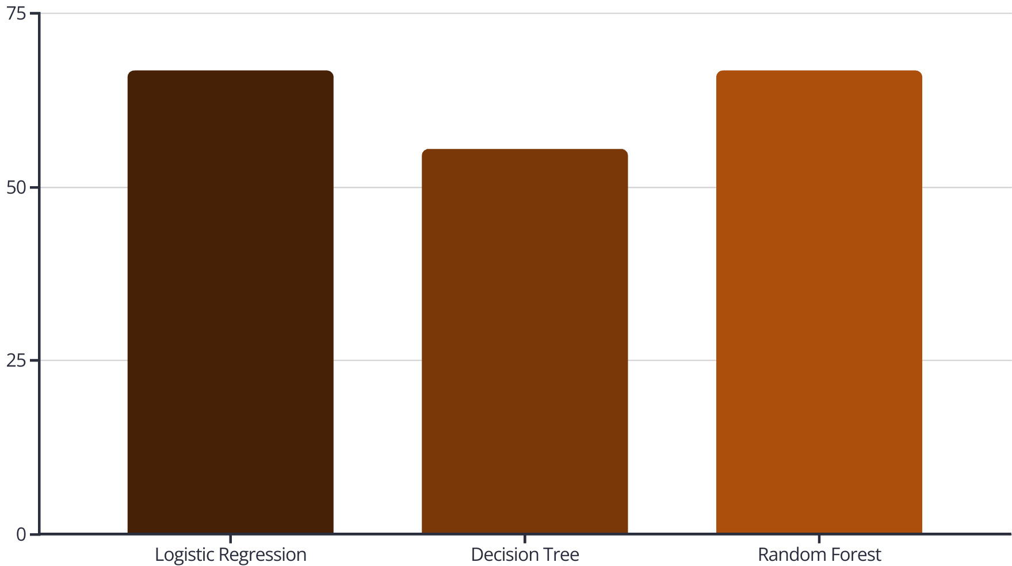
Model Performance Metrics

Slide 7
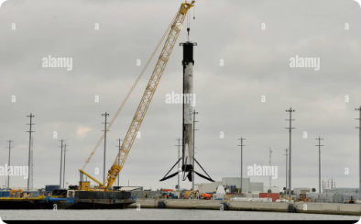
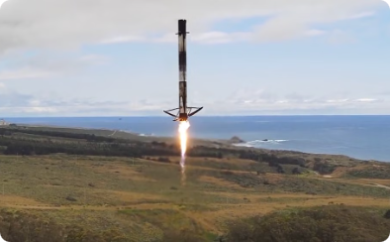
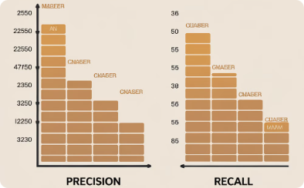
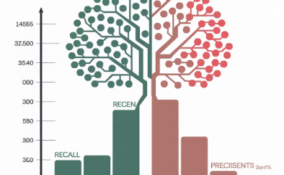
Evaluation Insights
True ASDS Prediction
True RTLS Prediction
Class Imbalance
Decision Tree Struggles
Models generally predict true ASDS outcomes well.
Models also perform well on true RTLS predictions.
Models underperform on minority classes like false ASDS.
Decision Tree has good recall but low precision.
Next Steps
Resample data to address class imbalance
Tune hyperparameters to optimize model performance

Slide 8
Methodology Recap
Data Collection
1
From SpaceX Launch Dataset
Data Cleaning
2
Handling missing values, encoding, date processing
Model Building
3
Logistic Regression, Decision Tree, Random Forest
Model Evaluation
4
Accuracy, precision, recall, F1-score
Challenges
5
Class imbalance, underperforming categories

Slide 9
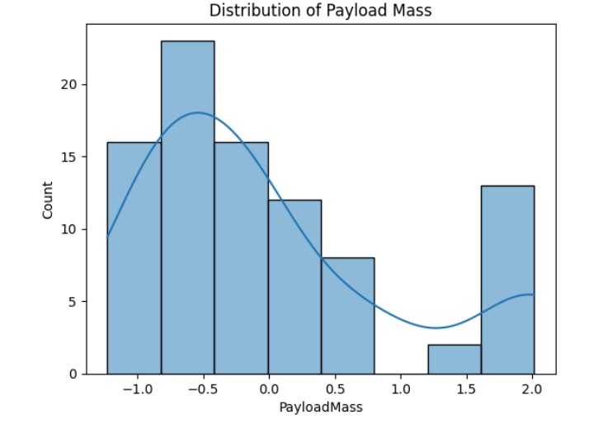
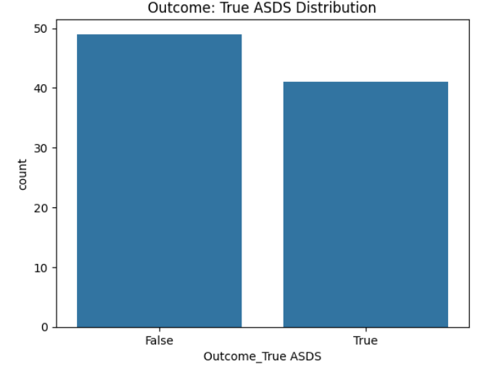
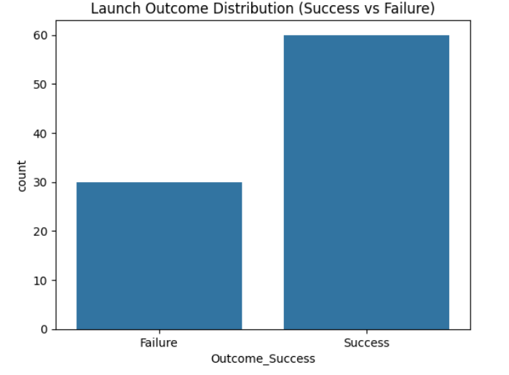
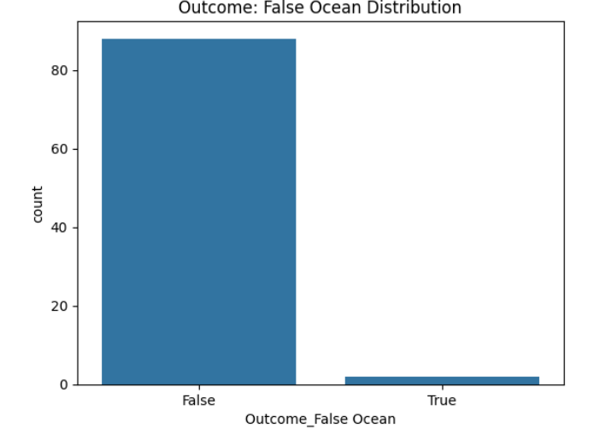
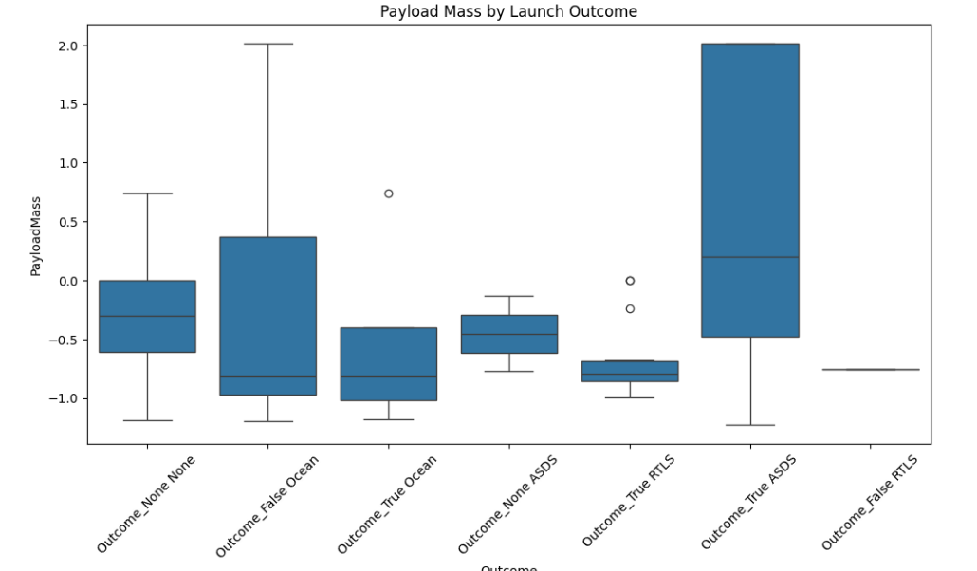
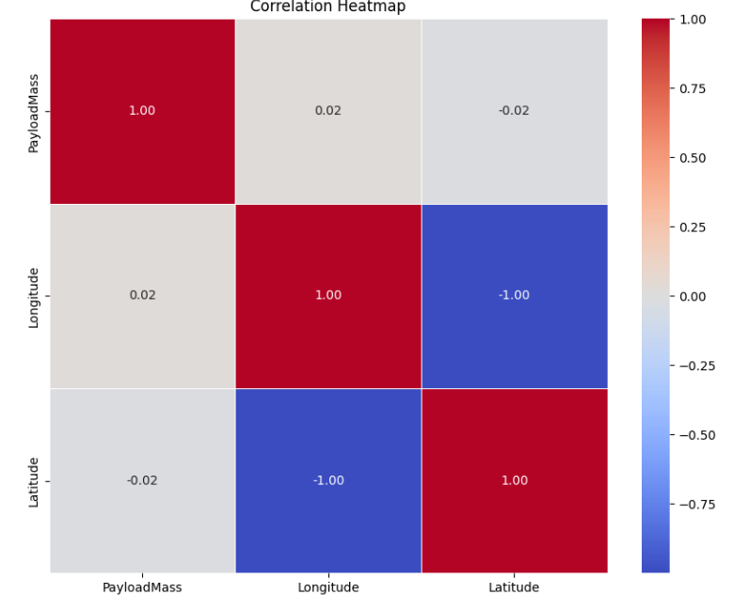
Visualizing the Data
Explore key visualizations to understand SpaceX launch data.
Analyze payload mass distribution, launch outcomes, feature correlations, and payload mass across different results.

Slide 10

Expected Results
Predictive Model
Reusability Insights
Predict SpaceX launch success from historical data.
Analyze cost benefits of rocket reusability.
Cost Optimization
Identify key cost drivers, provide efficiency recommendations.

Slide 11
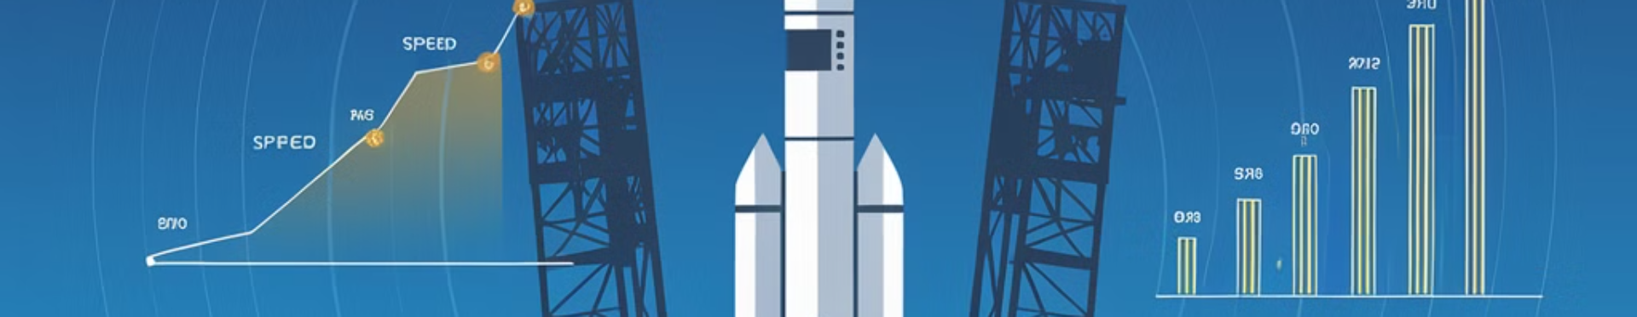



Conclusion
Predictive Analytics
Cost Optimization
Continuous Monitoring
Provide SpaceX with valuable predictive insights.
Actionable insights for improved operational efficiency.
Optimize launch processes through ongoing monitoring.

Slide 12

Questions & Discussion
Open the floor for any questions or clarifications.

